Slide 1
미니프로젝트
FISH MODEL

Slide 2
Slides Content
Introduction to fish model.
Purpose.
Transfer learning
Datasets.
Part 1: Clone dataset zip files to your google drive.
Part 2: Mount google Drive to Colab and extract data
Part 3: Import libraries and load data.
Part 4: Fish model
Exercise

Slide 3
INTRODUCTION

Slide 4
Purpose
Build a deep CNN model to recognize 10 fish species.
Apply transfer learning technique to improve model performance.
Thanks to D.H. Kim, S.S. Park, J.H. Park for
collecting dataset
initial model/code
Use the dataset only for this class

Slide 5
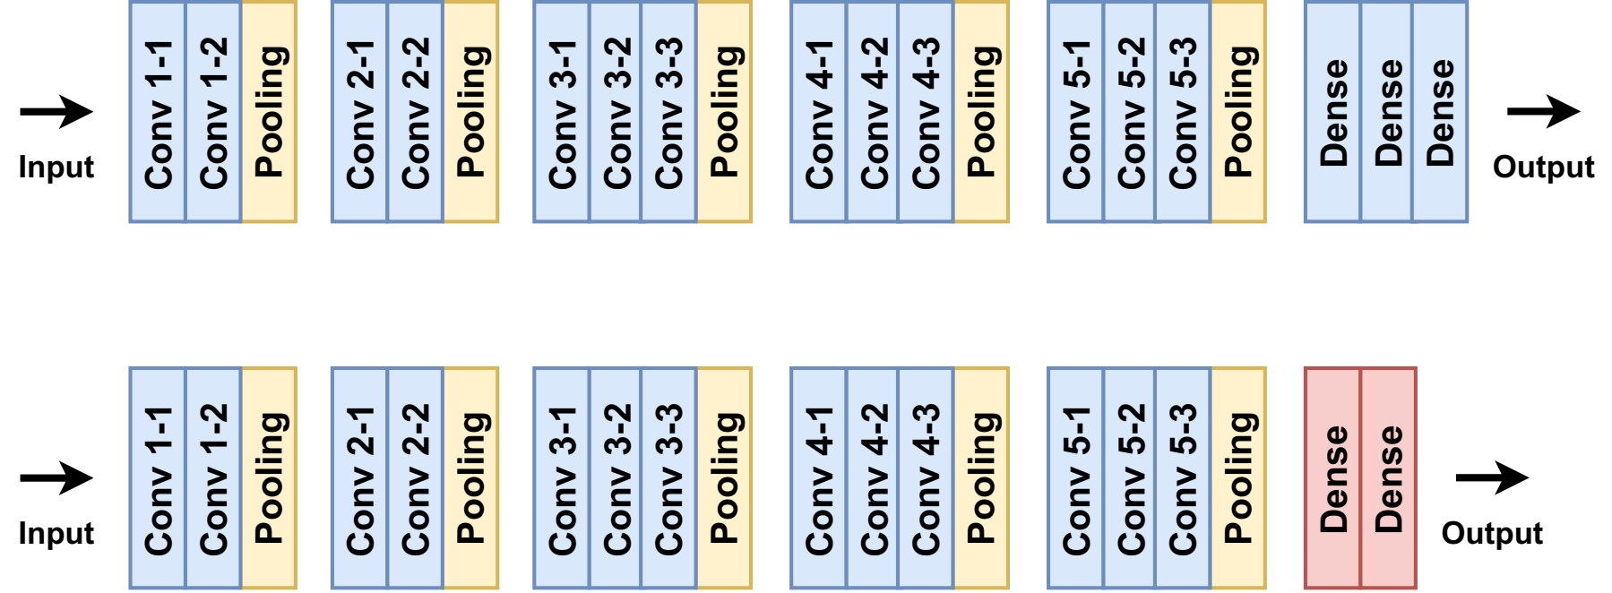
Transfer learning
VGG16 trained on ImageNet data
Our fish model
Re-use pre-trained weights
Add two new dense layers to the top

Slide 6
Dataset
Fish categories: '1_Ko_dung_uh', '2_Thom_bang_yi', '3_Bang_uh_dom', '4_Bum-dom', '5_Yong-chi', '6_Cham_dom', '7_Jul_jun', '8_Gam_sung_dom', '9_Nong_uh’, '10_Kanari’
Fish_data:
Training: ~700 images for each fish category.
Test: 20 images for each fish category.
Fish_data_small:
Training: 200 images for each fish category.
Test: 20 images for each fish category.

Slide 7
PART 1: CLONE DATASET ZIP FILES TO YOUR GOOGLE DRIVE

Slide 8
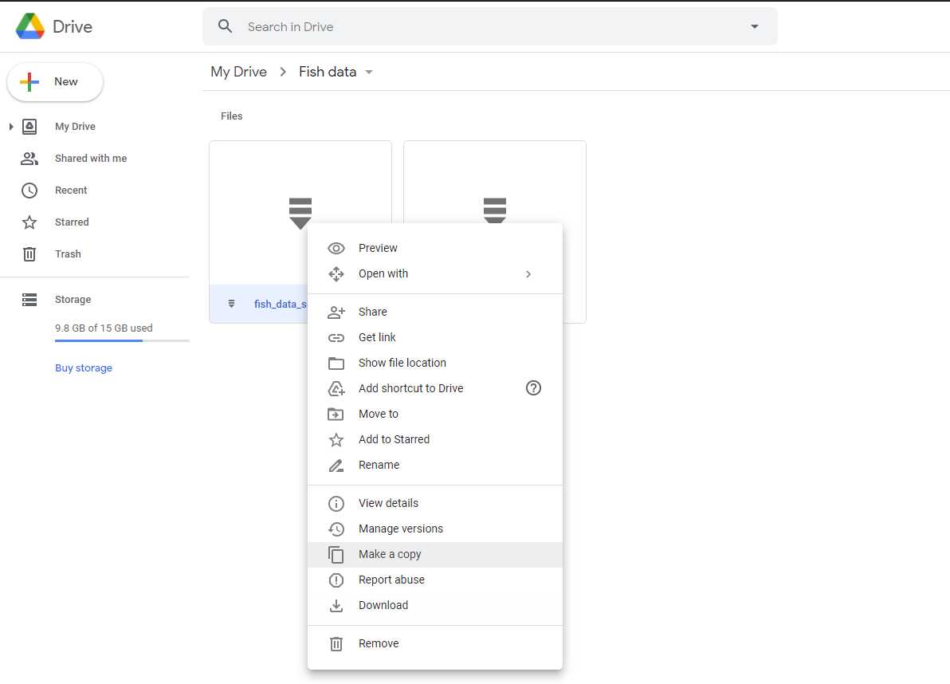
Make a copy of data zip files to your Google drive
https://drive.google.com/drive/folders/1Np2ewekFStsSltJfCk_QU2_DhdKniAzq?usp=sharing
Right click > Make a copy

Slide 9
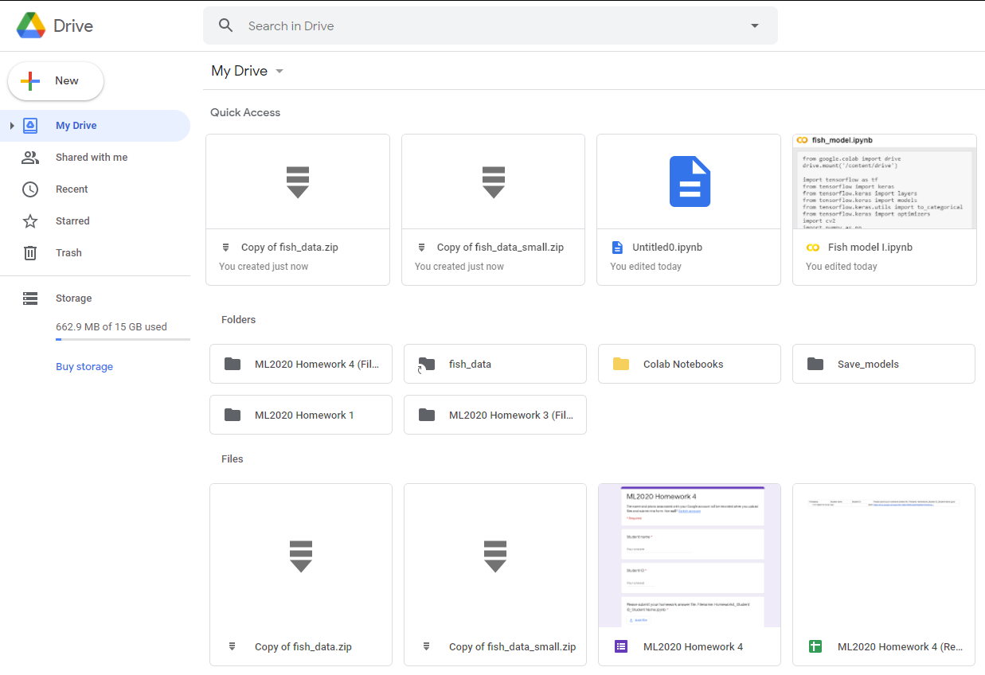
Data zip files in your google drive

Slide 10
PART 2: 코랩에서 구글드라이드 마운트와 데이터 복사
MOUNT GOOGLE DRIVE TO COLAB AND EXTRACT DATA

Slide 11
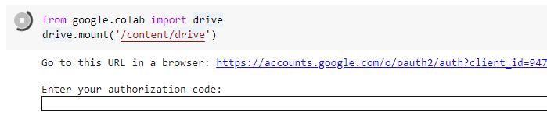
Mount Drive to Colab
Access to the given link

Slide 12
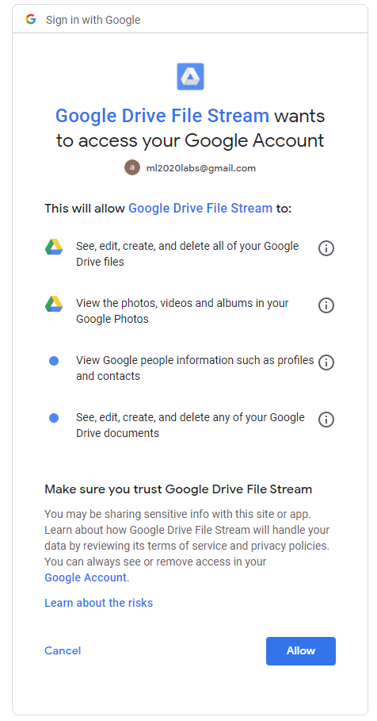
Mount Drive to Colab
Signing and Allow

Slide 13
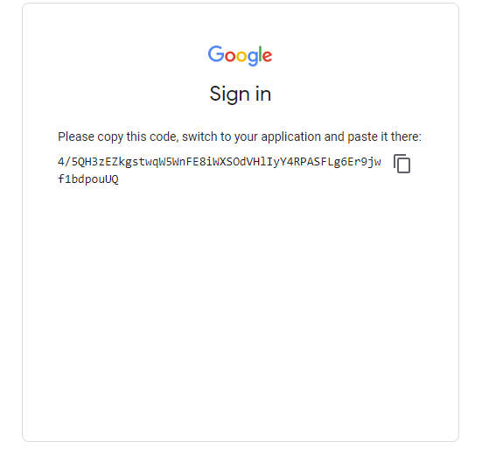
Mount Drive to Colab
Copy the code

Slide 14
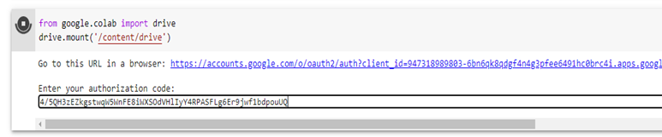
Mount Drive to Colab
Paste the security code here and “Enter”

Slide 15

Mount Drive to Colab
Drive mounted

Slide 16
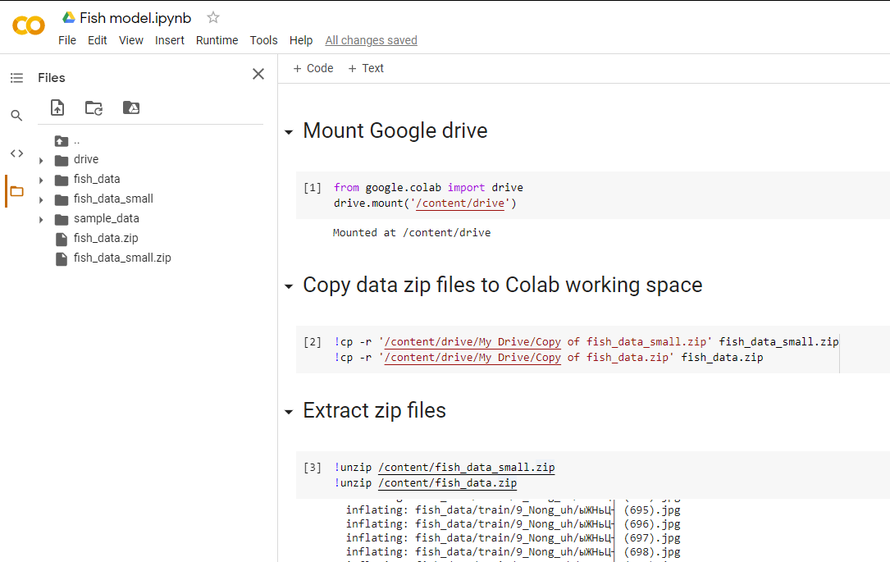
Copy data zip files to Colab working space an unzip files

Slide 17
PART 3: IMPORT LIBRARIES AND LOAD DATA

Slide 18
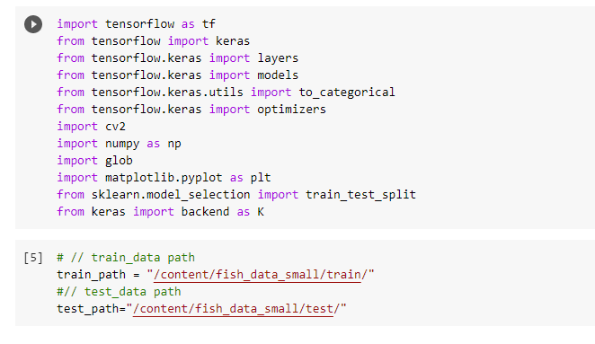
Libraries and define data paths
For this lab, we use small data to save time.

Slide 19
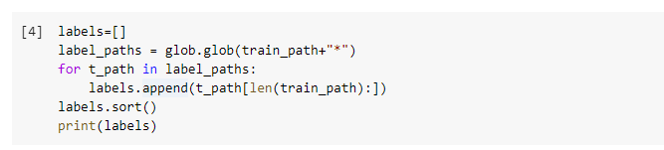
Get the data labels
['10_Kanari', '1_Ko_dung_uh', '2_Thom_bang_yi', '3_Bang_uh_dom', '4_Bum-dom', '5_Yong-chi', '6_Cham_dom', '7_Jul_jun', '8_Gam_sung_dom', '9_Nong_uh']

Slide 20
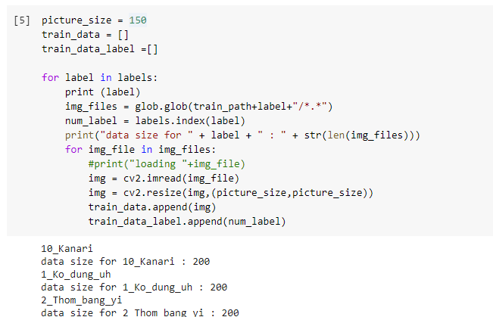
Load training data

Slide 21
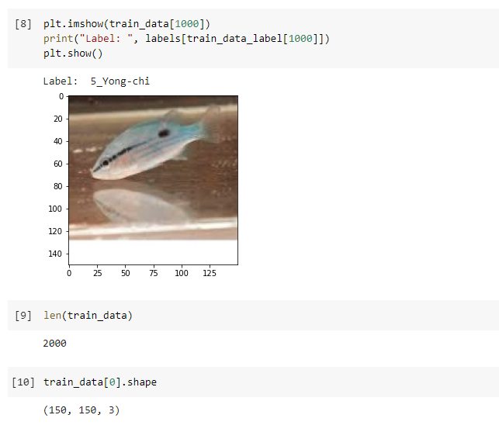
Check loading data

Slide 22
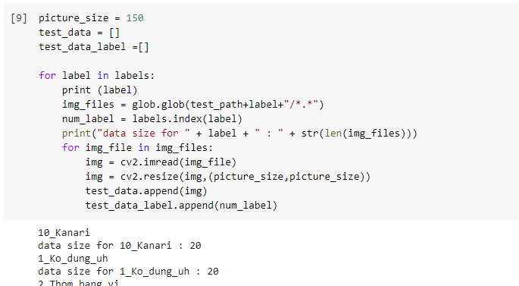
Load test data

Slide 23
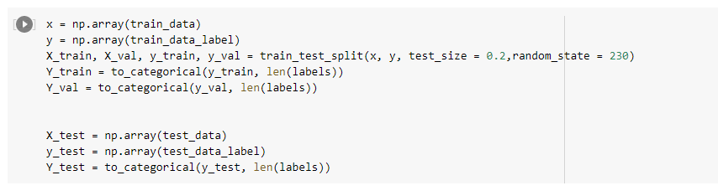
Training-validation-test set
로드한 데이터로 부터
훈련셋, 검증셋, 테스트셋 생성
train_test_split(x, y, test_size = 0.2, random_state = 230)

Slide 24
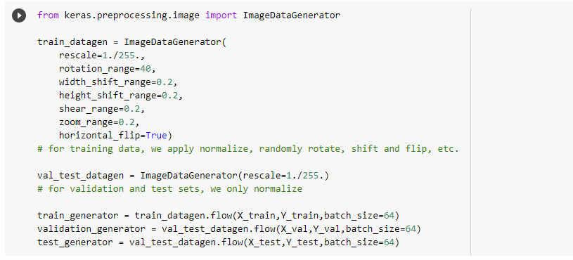
Preprocessing

Slide 25
PART 4: FISH MODEL

Slide 26
Transfer learning
Not use
VGG16 trained on ImageNet data
Our fish model
Re-use pre-trained weights
Add two new dense layers to the top

Slide 27
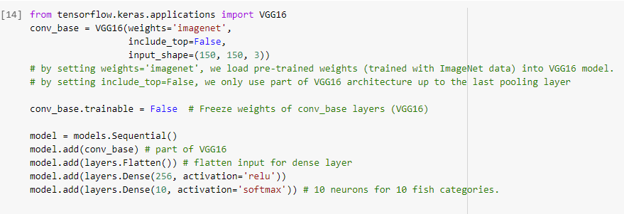
Create fish model using a part of VGG16
VGG16을 베이스모델로 하여 훈련 모델생성

Slide 28
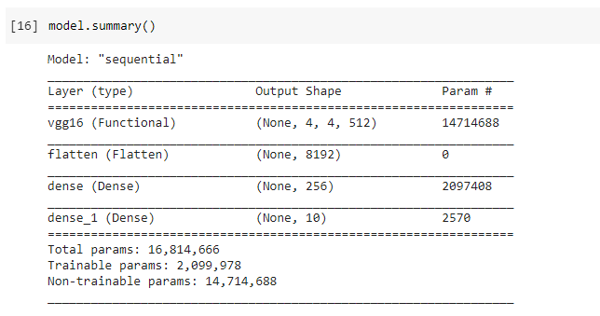
Fish model
Freeze weights
2 new dense layers

Slide 29
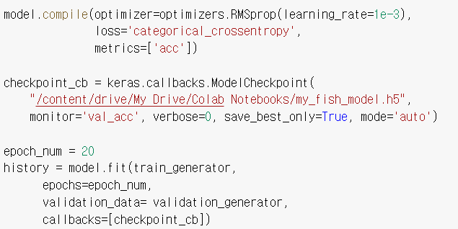
Train fish model with callbacks checkpoint
모델 훈련, 체크포인트 콜백함수를 호출

Slide 30
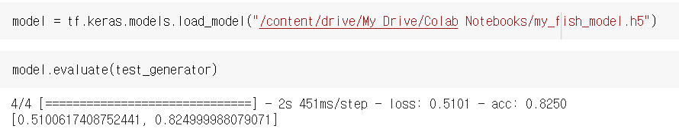
Reload and evaluate the model
모델 복원 및 평가

Slide 31
미니프로젝트

Slide 32
미니프로젝트
< Tips>
learning curve를 텐서보드를 사용해 시각화하면 모델 최적의 하이퍼-파라미터(hyper-parameters)를 찾는데 도움이 될 것이다.
[Use tensorboard callbacks to visualize learning curves may be helpful when optimizing model hyper-parameters.]
Question 1: 테스트셋에서 90%이상의 정확도를 갖도록 Fish model을 최적화(하이퍼파라미터 등)하시오.
[Optimize the fish model above to achieve over 90% accuracy point on test set.]
Question 2: 다른 사전훈련 모델 (예. ResNet50, InceptionV3, etc.)를 기본모델로 하는 전이학습모델을 만드시오
[Use a different pre-trained model (e.g., ResNet50, InceptionV3, etc.) as base model for the fish model above.]
뒷장에 계속

Slide 33
미니프로젝트
Question 3: 전이학습을 하지 않는 별도의 CNN모델을 만드시오. 이 모델은 fish_data_small 데이터셋에서 70%이상의 정확도를 보여야만함.
[Build your own CNN model (i.e., do not use the pre-trained model) which achieves over 70% accuracy point on fish_data_small dataset.]
Question 4: Tensorboard를 이용하여 Q1 및 Q3모델의 학습곡선(loss, accuracy)와 모델구조(계산그래프)를 보이시오.

